Slide 1
Finding the optical properties of plasmonic structures by image processing using a combination of convolutional neural networks and recurrent neural networks
Iman Sajedian, Jeonghyun Kim, Junsuk Rho
Presented by Tianyu Liang
SCUT Machine Intelligence Laboratory
Nov 19, 2021

Slide 2
Contents
1
Background
2
Motivation
3
Proposed Method
4
Experimental Results
5
Conclusion

Slide 3
Contents
1
Background
2
Motivation
3
Proposed Method
4
Experimental Results
5
Conclusion

Slide 4
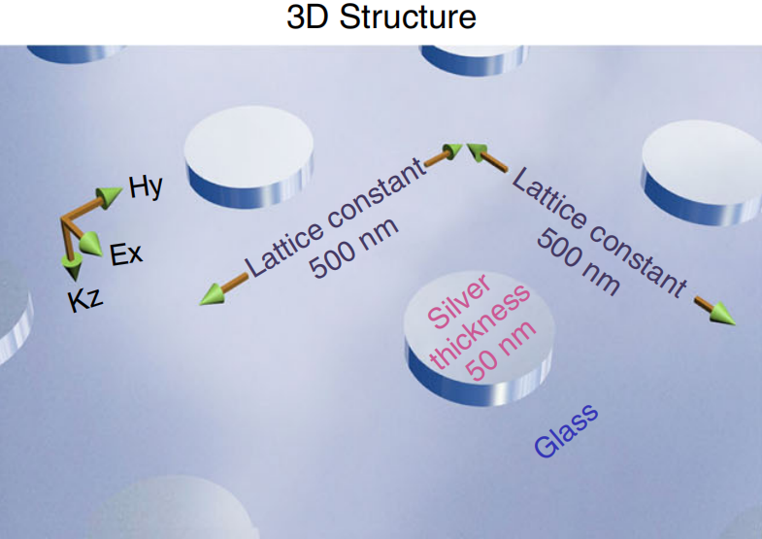
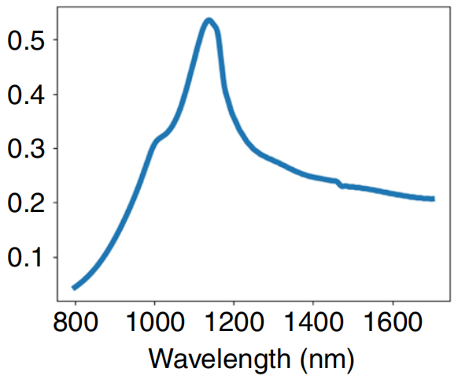
Optical nanostructures
Deep neural networks have been used to solve problems in many fields.
Regarding the optical nanostructures:
geometric parameters → optical response, how to connect them efficiently?
3D-structure
Absortion spectrum

Slide 5
Numerical simulations
Limitation for conventional numerical simulations method:
(i) Time- and computationally-intensive.
(ii) Not always accurate.
(iii) Requiring strong computing systems.

Slide 6
Contents
1
Background
2
Motivation
3
Proposed Method
4
Experimental Results
5
Conclusion

Slide 7
Motivation
Motivation of the proposed method
CNNs + RNNs been applied to find relationships in data (e.g. image labeling).
From these previous research, we know that:
(i) CNNs extracts the spatial information.
(ii) RNNs finds the relationship between image and optical features.
(iii) Combination.

Slide 8
Contents
1
Background
2
Motivation
3
Proposed Method
4
Experimental Results
5
Conclusion

Slide 9
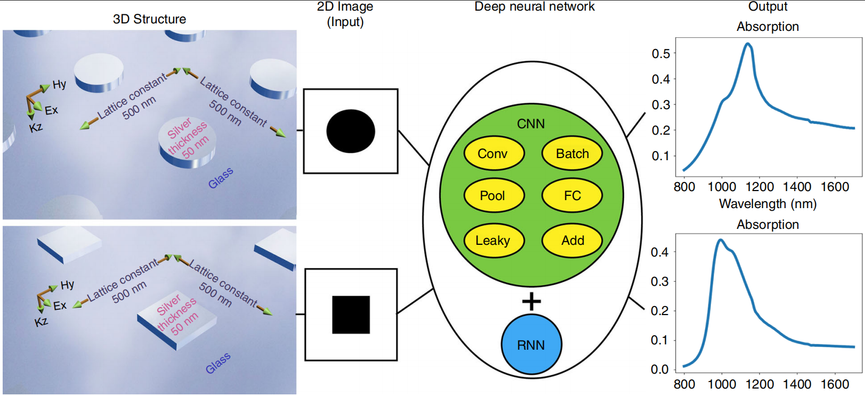
Overview
3D-Structure → 2D-Image → CNNs → RNNs → Abosortion Curve
How to map 3D-Structure to 2D-Image ? -- Fixed thickness and cross-section
What is the model layout of the CNNs + RNNs ?

Slide 10
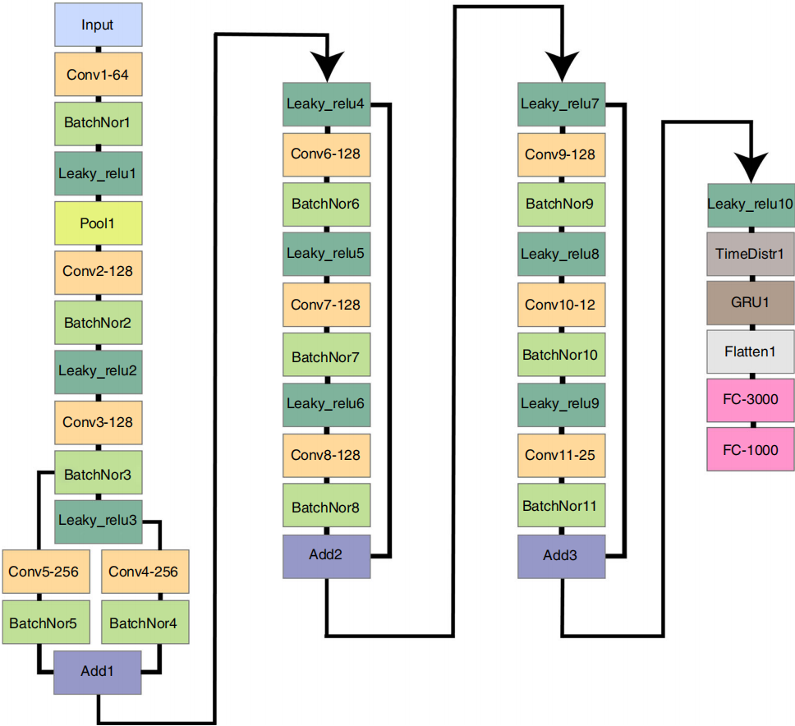
Networks
Shortcuts: Avoid gradients vanishing, deeper networks.
Batch normalization: avoid overfitting.

Slide 11
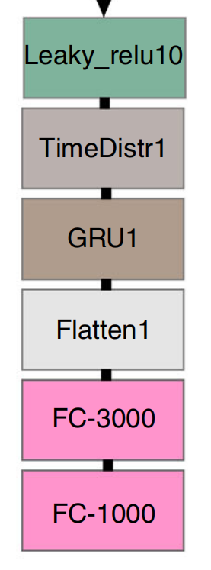
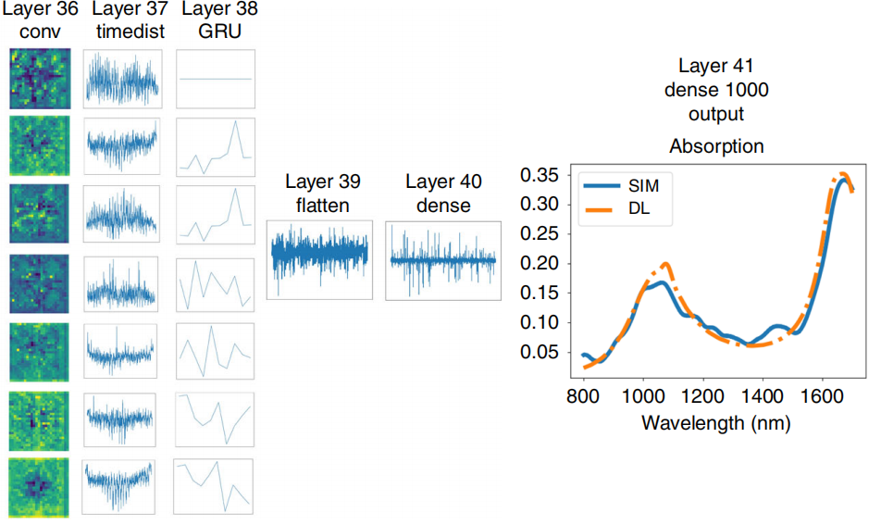
Networks
Time distribute layer: coding technique, fiting the output of CNNs into input shape of RNNs.

Slide 12
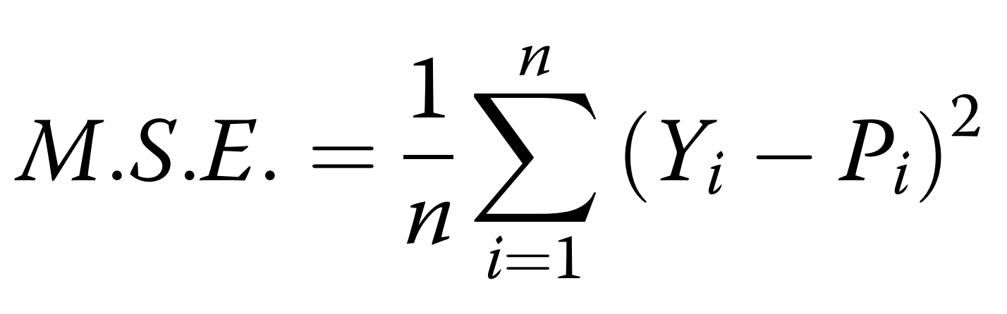
Loss
Loss function was defined as the Mean Squared Error:
Y → vector of real values
P → vector of predictions

Slide 13
Contents
1
Background
2
Motivation
3
Proposed Method
4
Experimental Results
5
Conclusion

Slide 14
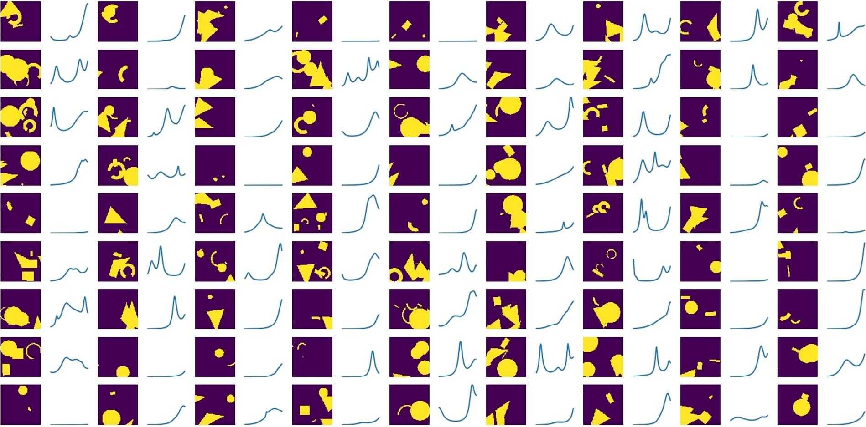
Experimental Results
Training set
Lumerical: 100,000 simulations (1000 frequency points each)
Black and white picture (100 × 100 pixels)

Slide 15
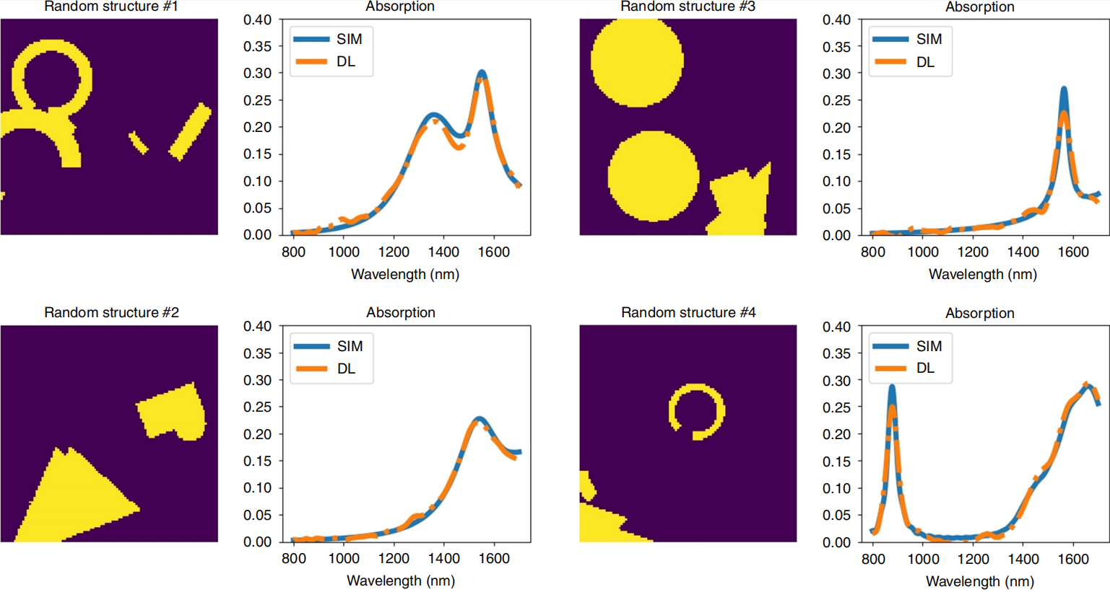
Experimental Results
Proposed method compared with simulation
Results correlates very well to the simulated absorption curves.

Slide 16
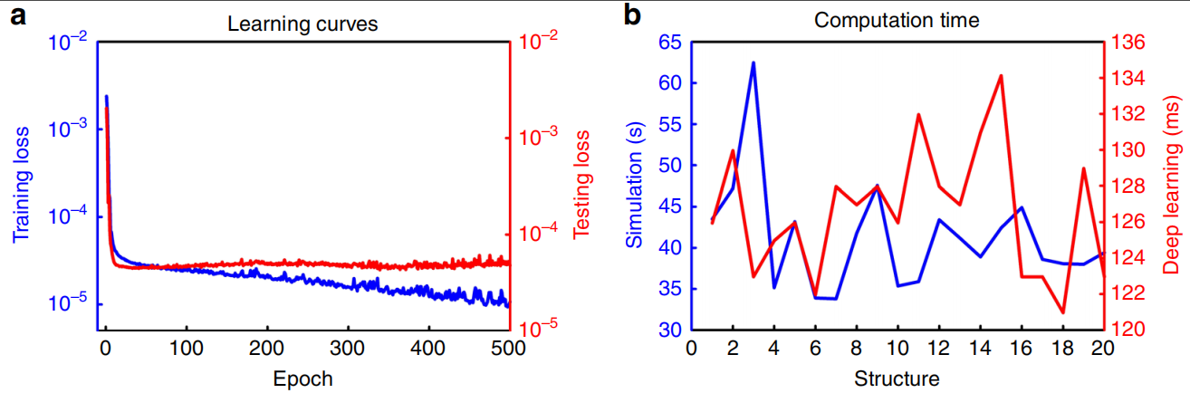
Experimental Results
Computation time comparison
500 epochs were run.
CNNs+RNNs is 400+ times faster than the simulation.

Slide 17
Contents
1
Background
2
Motivation
3
Proposed Method
4
Experimental Results
5
Conclusion

Slide 18
Conclusion
Contributions
A method using image processing batter than numerical simulations to determine the optical properties of structures was introduced. (less time-comsuming)
This method can be generalized for other structures.

Slide 19
Thank You
Thank You
Q&A

